Slide 1
Getting started with SharePoint Framework
SharePoint Framework Client-side Components

Slide 2
Agenda
Overview
Web parts
Demos
Q&A

Slide 3



SharePoint Framework Components
User Experience
Packaging
Build Process & Tooling
Client-Side web parts Modern Page Canvas JavaScript Resource Management Page Context & Site Data APIs
Client-side Solutions Tenant-Scoped Deployment
Yeoman Templates Gulp-based Build Process SharePoint Workbench
Notes:
SharePoint Framework helps you to extend key SharePoint experiences using client-side components. Today, client-side web parts allow developers to build components that page authors can extend SharePoint pages experience. As Microsoft introduces new SharePoint experiences, the framework will provide the respective client-side components to extend such experiences.

Slide 4
SharePoint Client-side web parts

Slide 5
SharePoint web parts
Configurable, reusable, purpose built components
Add functionality to SharePoint experiences
Web Parts
Framework for connecting related components
Context aware parts
Notes:
Main point: Keep light on vision, more on outline for today and why we are investing in our innovation areas influenced by where we are seeing the most usage (outside circle), consistently influenced by our productivity pillars (inside circle)

Slide 6
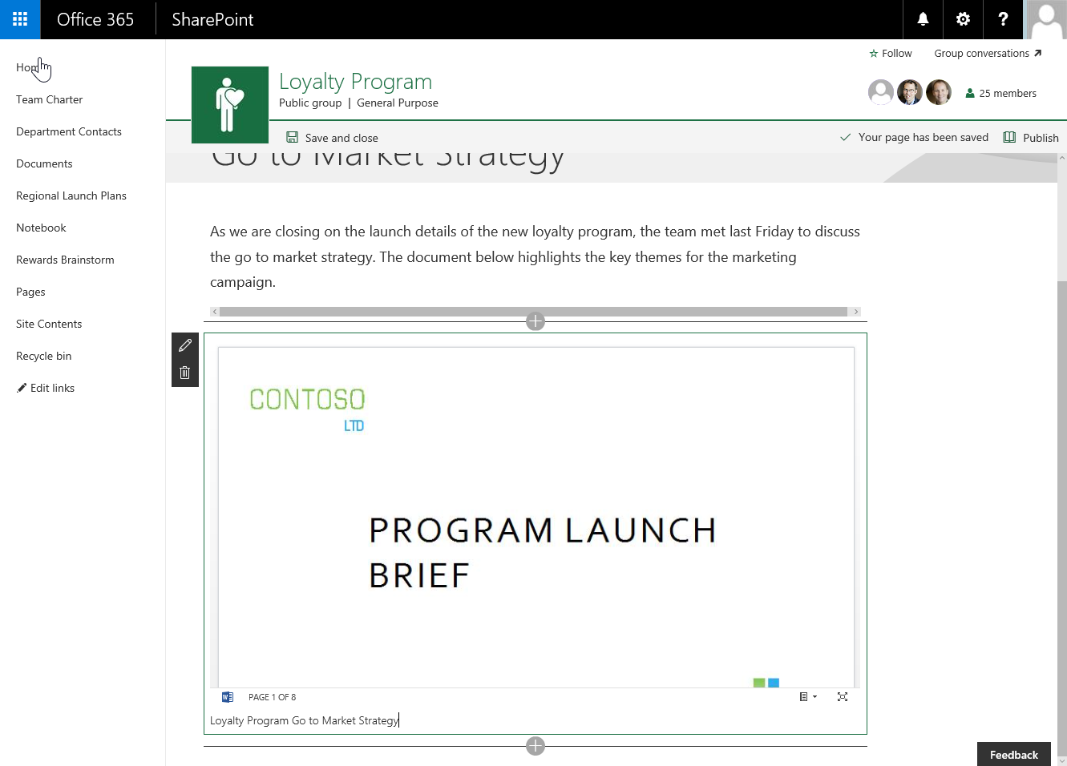
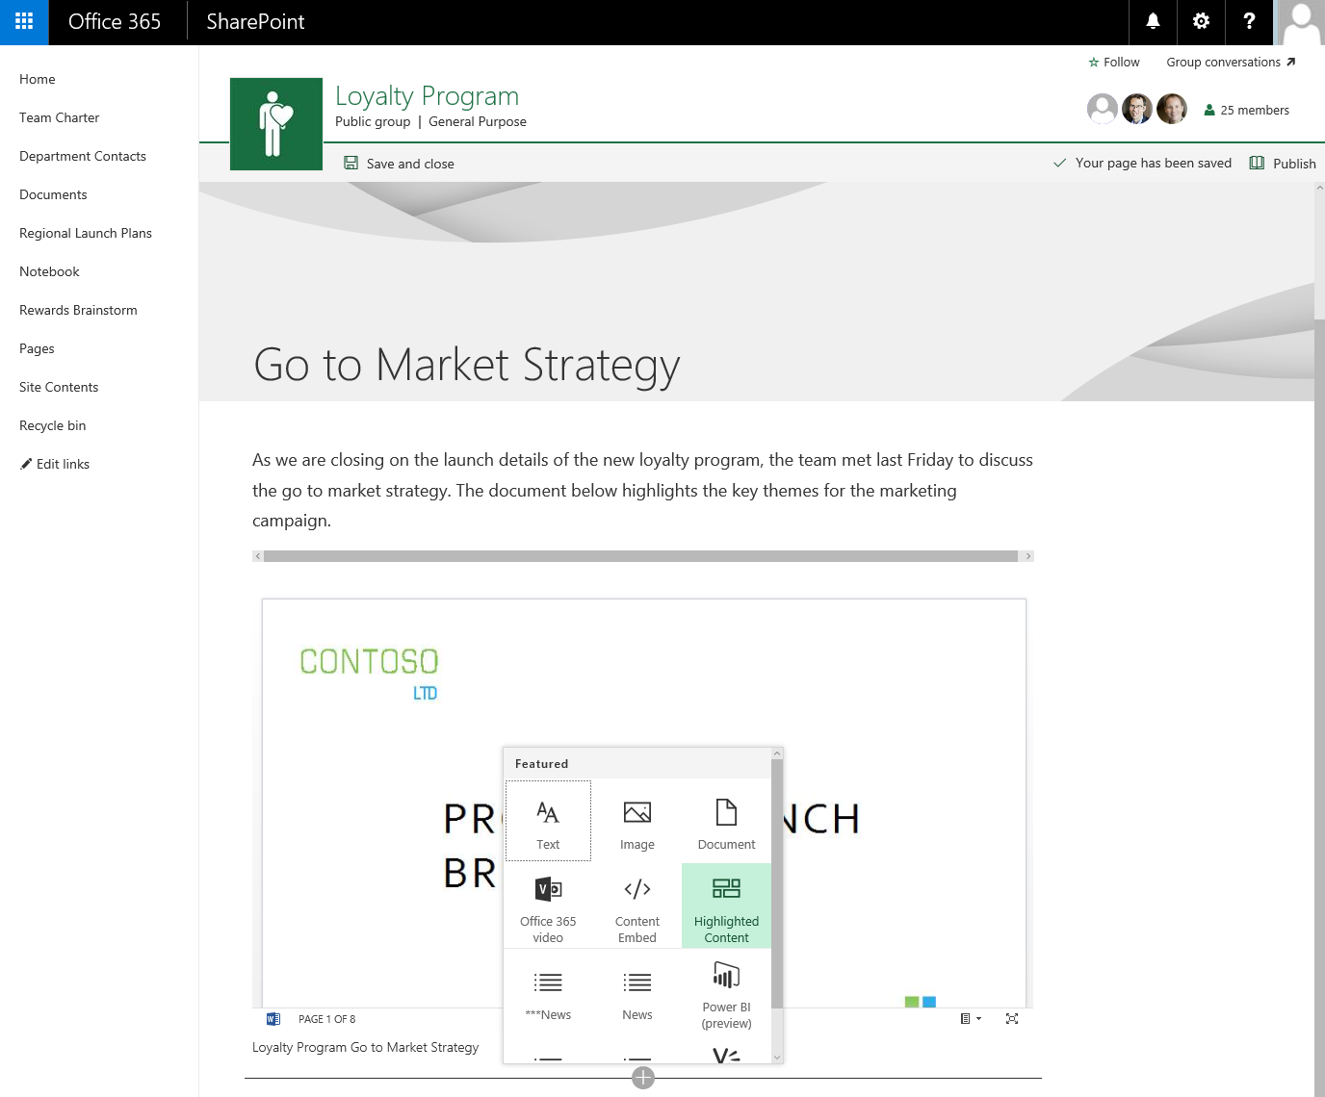
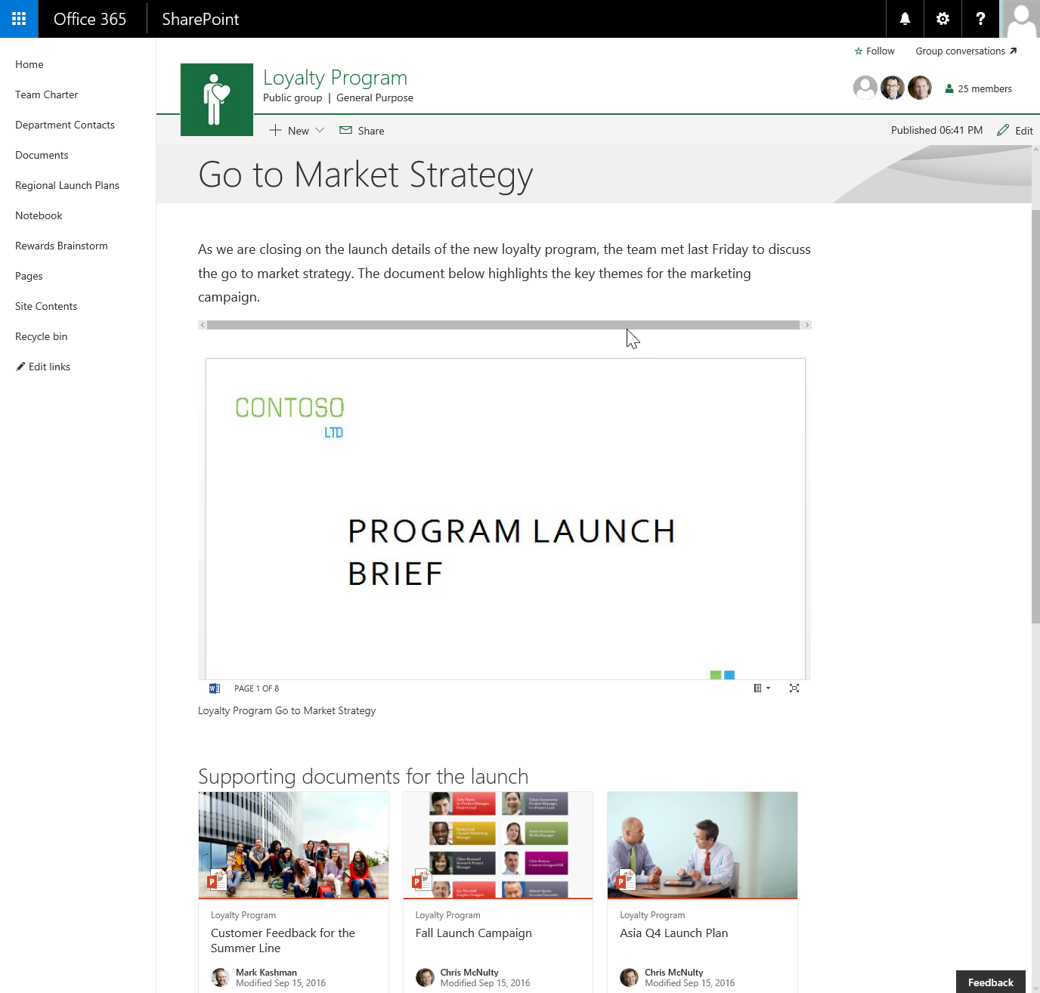
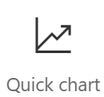
Client-side web parts
They are still web parts!
Built for the modern, JavaScript-driven web
Runs directly inside a SharePoint Page

Slide 7
DEMO
Custom client-side web parts in SharePoint
Notes:
Use samples in this GitHub repository for the demos:
https://github.com/SharePoint/sp-dev-fx-webparts/tree/dev/samples
Examples:
https://github.com/SharePoint/sp-dev-fx-webparts/tree/dev/samples/react-todo-basic
https://github.com/SharePoint/sp-dev-fx-webparts/tree/dev/samples/react-organisationchart
https://github.com/SharePoint/sp-dev-fx-webparts/tree/dev/samples/react-officegraph

Slide 8
Summary
Overview
Web parts
Demos
Q&A

Slide 9

Sharing is caring…
Code samples and solutions
Reusable components
Guidance documentation
Monthly community calls
SharePoint Framework
SharePoint add-ins
Microsoft Graph
Office 365 APIs
http://aka.ms/SharePointPnP

Slide 10

Q&A

Slide 11


